Slide 1
Game Playing
Adversarial Search

Slide 2
Introduction
The first successes of artificial intelligence researches can be connected to games
The computer program, that was able to play through a full game of chess was created by Alan Turing in 1951.
When we try to transplant a game to computer, we have to give the following information in some way:
    the possible states of the game
    the number of players
    the regular moves
    the initial state
    if randomness has any part in the game
    when will the game end and who will win

Slide 3
Introduction
A game can be categorized as follows:
  By the number of players:
    2-player games
    3-player games etc..
  By the role of randomness
    Deterministic games: randomness plays no role
    Stochastic games: randomness plays role
  By finiteness
    Finite games: all players have finite moves and the game will end after finite moves
  By profit and loss: Evaluation Function
    Zero-sum games: the total of the players' profit and loss is zero
Here, we will deal with 2-player, finite, deterministic, full information, zero-sum games

Slide 4
State-space representation
Any game can be represented by state-space representation as follows:
  The forms of states are (a , p) , where a is a state of the game and p is the player who is next. The players will be marked with MAX and MIN , so p∈{MAX, MIN} .
  In every goal state, it must be given exactly that who wins or loses in that given state or the game is a drawn
  Every operator o (invariably) has a precondition of the operator and a function of applying the operator.

Slide 5
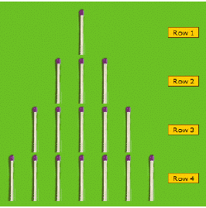
Examples: NIM
There are match-sticks in n pieces of mounds. The player with the next move can take any amount of matches (at least one and no more than the number of matches in the mound) from a chosen mound. The players take turns. Whoever takes the last match-stick loses the game.

Slide 6
Examples: NIM
Set of states: In the states, we store the number of matches in a mound. Let the state be an n -tuple, where n>0 is a constant out of the state-space, denoting the number of the mounds. A number max>0 must be also given in advance, which maximizes the number of matches in the mound. Naturally, the state must store the mark of the player with the next move.
So the set of states is the following:
A={(a1,a2,…, an , p)∣ ∀ i, 0≤a_{i}≤max , p∈{MAX,MIN}}

Slide 7
Examples: NIM
Initial state: The initial state k can be any state, so the only clause is the following: k ∈A
Set of goal states: The game ends when all of the mounds are empty. The player who takes the last match loses the game, so the player with the next move wins. Namely: C={(0,..,0 , p)}⊆A , p wins
Set of operators: The operators remove some matches from the mound. So the set of our operators is:
O={remove_{mound , pcs} ∣ 1≤mound≤n , 1≤ pcs≤max }

Slide 8
Examples: NIM
Precondition of the operators: the precondition of the operator remove_{mound , pcs} to the state (a1 ,.., an , p) is: a_{mound}>0 ∧ pcs≤a_{mound}
Function of applying:
remove_{mound , pcs}(a1 ,.., an , p)=(a '₁ ,.., a '_{n} , p ‘) where
    a '_{i}={a_{i}− pcs , if i=mound
        a_{i} , otherwise where 1≤i≤n
    p '={MIN , if p=MAX
      MAX , if p=MIN

Slide 9
Example: TIC-TAC-TOE
On the 3x3 game board, the players put their own marks in turns. The winner is who puts 3 of his or her marks in a row, in a column, or in a diagonal line. The outcome of the game can be a drawn if the game board is full but no one has 3 marks abreast.
Set of states: In the states we need to store the whole 3x3 game boards, and of course the mark of the player with the next move. One cell of the 3x3 matrix is 0 if none of the players has put a mark there.

Slide 10

Example: TIC-TAC-TOE
So the set of states is defined as follows:
A={(T_{3×3} , p) ∣ ∀ i , j, T_{i , j}∈{0,MAX ,MIN} , p∈{MAX ,MIN}}
Initial state: In the initial state the game board is completely empty, and player MAX is going to put his or her mark first

Slide 11
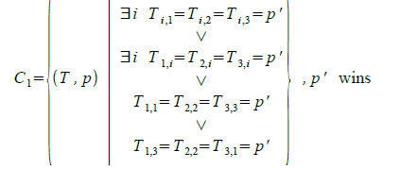
Example: TIC-TAC-TOE
Set of goal states: The game may end because of two reasons:
    One of the players has 3 marks abreast.
    The game board is full.
Namely: C=C1∪ C2 , where
And C2={(T , p)∉C1 ∣ ￢∃_{i , j} T _{i , j}=0 } , drawn

Slide 12
Example: TIC-TAC-TOE
Set of operators: Our operators put the mark of the current player into one cell of the board. So, the set of our operators is defined as follows: O={ put_{x , y} ∣ 1≤x , y≤3}

Slide 13
Game Tree And Strategy
Game begins at an initial state & ends in a position that using a simple criterion can be declared as a win/ loss for one player or a draw
Initial state and the legal moves for each player are represented as a game tree
For a game program to be able to decide the next move of a player, it needs a strategy.
Strategy is defined by a function, named as Evaluation function/ Static evaluation function

Slide 14
Game Tree And Strategy
Evaluation function is used to evaluate the “goodness” of a configuration of the game
Instead of modeling the two players separately, a single function f(n) is used to describe the goodness of a board position with respect to both the players.
If f(n) = large (+ve) value then, the board position associated with node n is good for me and bad for you
If f(n) = large (-ve) value then, the board position associated with node n is good for you and bad for me and f(n) near 0 means that the board is neutral

Slide 15
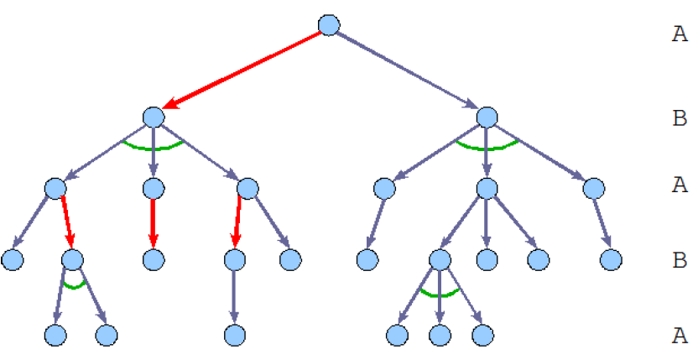
Game Tree And Strategy
To represent the possible strategies of the player p∈{A ,B} , then we transform the game tree into an AND/OR-graph in the following way:
  with an arc we conjoin all the edges that start from a vertex in which the opponent of p moves.

Slide 16
Game Tree
Root node represents the configuration of the board at which a decision must be made as to what is the best single move to make next
If it is my turn to move then the root is labeled as “MAX”, otherwise it is labeled as “MIN”
Each level of the tree has nodes that are all MAX or all MIN
Each path from the root to a terminal node represents a different complete play of the game

Slide 17
Game Tree
MAX (x)
x
 | x
 |  | x
x
 | x
 |  | x
MIN (o)
x | o
x |  | o
x
o
MAX (x)
……

Slide 18
MINIMAX Algorithm: Strategy
For finding the move to be played by a computer from a given board position the following strategy is supposed to be followed:
Generate the game tree up to a given depth
For each terminal board position j generated at look ahead depth, evaluation function is applied to calculate the merit of the board position
These scores are propagated upward to find the best possible moves
At MIN nodes, the backed up value is the minimum of the values associated with its children and at the MAX nodes, maximum of the values

Slide 19
Example
MAX 3
MIN 3 2 2
3 12 8 2 4 6 14 5 2
Note: Better is the evaluation score, better will be the
decision

Slide 20
MINIMAX Algorithm
begin
v = value (root);
output (v);
end
function value (n: node): integer
var cvalue: integer;
begin
if n is a terminal node then return e(n);
if n is a MAX node then cvalue = -∞;
if n is a MIN node then cvalue = ∞;
for each successor n_{i} of n do
begin
generate n_{i};
if n is a MAX node then
cvalue = max(cvalue, value(n_{i}));
else
cvalue = min(cvalue, value(n_{i}));
end
return cvalue;
end

Slide 21
Example: Tic-Tac-Toe
Statement: Let’s assume that MAX marks cross (x) and MIN marks circles (o) in this game. Static evaluation function e(p) for a given board position p may be defined as follows:
i) if p is not a winning board position for either player, then
e(p) = (number of complete rows, cols, or diagonals that are still open for MAX) – (number of complete rows, cols, or diagonals that are still open for MIN)
ii) if p is a win for MAX then e(p) = ∞ and if win for MIN then e(p) = -∞

Slide 22
Example: Tic-Tac-Toe
MAX
MIN
x
 | x
x
x
o
x
o
x
 | o
x
 |  | o
x
 | o
o
 | x
o | x
o
x
 | o
x
 |  | o
x
x |  | o
x | o

Slide 23
Example: Tic-Tac-Toe
MAX
1
-2
-1
MIN
x
 | x
x
1
x
o
x
o
x
 | o
x
 |  | o
x
 | o
o
 | x
o | x
o
x
 | o
x
 |  | o
x
x |  | o
x | o
6-5=1 5-5=0 6-5=1 5-5=0 4-5 = -1 5-4=1 6-4=2 5-6=-1 6-6=0 5-6=-1 6-6=0 4-6=-2

Slide 24
Properties: MINIMAX
Complete? Yes, if the tree is finite
Time complexity? O(b^{m})
Space Complexity? O(bm)
Disadvantages:
  If we choose a high value for maxDepth , then the generated tree (and also, the time-demand of the minimax algorithm) will be very large.
  So, it is worth optimizing the algorithm, based on the observation that it is often unnecessary to generate certain parts of the tree.
  Eliminating these parts is the main goal of the alpha-beta pruning.

Slide 25
ALPHA-BETA Pruning
With the alpha-beta pruning, we can interrupt the expansion of a certain vertex.
When this technique is applied onto a standard MINIMAX tree, it returns the same move as MINIMAX would, but prunes away branches that can’t possibly influence the final decision.

Slide 26


ALPHA-BETA Pruning
>=100 S MAX
100 A <=20 B MIN
200 100 120 20
Alpha cutoff
<=20 S MIN
A 20 >=25 B MAX
-10 -20 25
Beta Cutoff

Slide 27
ALPHA-BETA Pruning
At each non-leaf node, the best backed-up value found so far is stored
At MAX nodes, it is called alpha and at MIN nodes, it is called beta
Given a node n, cutoff the search below n if
  n is a MAX node and alpha (n)>=beta (i), for some MIN node ancestor i of n. This is called beta cutoff
  n is a MIN node and beta (n)<=alpha (i), for some MAX node ancestor i of n. This is called alpha cutoff

Slide 28
ALPHA-BETA Pruning Example
A MAX
B C D MIN
E F G H I J K
4 8 9 3 2 -2 9 -1 8 4 3 6 5 7 1

Slide 29
ALPHA-BETA Pruning Example
A MAX
B C D MIN
E F G H I J K
4 8 9 3 2 -2 9 -1 8 4 3 6 5 7 1
β
α α

Slide 30
ALPHA-BETA Pruning Example
a MAX
b c MIN
d e f g MAX
MIN h I j k l m n o
10 11 9 12 14 15 13 14 5 2 4 1 3 22 20 21

Slide 31
ALPHA-BETA Pruning Example
>=10 a MAX
<=10 b <=2 c MIN
>=10 d >=14 e 2 f g MAX
10 h <=9 i j 14 k l 2 1 m n o
10 11 9 12 14 15 13 14 5 2 4 1 3 22 20 21
α β
α

Slide 32
Remarks: ALPHA-BETA Pruning
Alpha-beta pruning is guaranteed to compute the same minimax value for the root node as computed by MINIMAX algorithm
In the worst case, alpha-beta does NO pruning
In the best case, it will examine only (2b)^{d/2} leaves
The best case occurs when each player’s best move is the leftmost alternative
In the chess program Deep Blue, Alpha-Beta pruning finds that the average branching factor at each node is about 6 instead of about 35 – 40

